Slide 1

Smart Rainfall Insights for Sustainable Growth
Pranjali Sambare

Slide 2


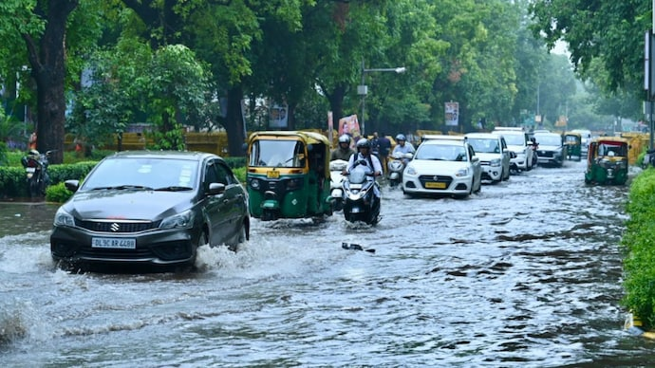
Problem Statement
Crop yields are heavily influence by rainfall patterns.
Weather impacts shopping behavior.
Rain impacts delivery efficiency and road safety.

Slide 3


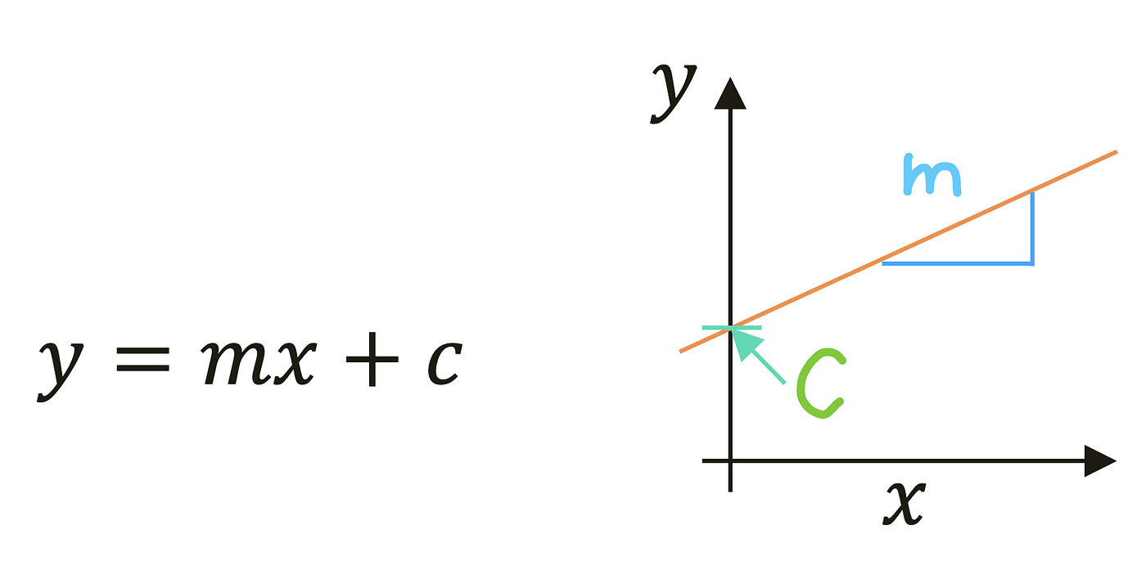
Problem Statement
Linear Regression -
How much rainfall will occur tomorrow?
Logistic Regression:
Will it rain tomorrow?
What category does tomorrow's rainfall fall into?

Slide 4
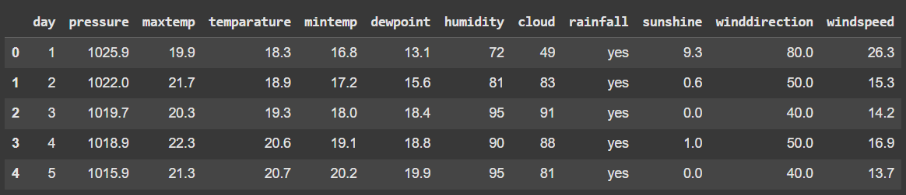
Data- Preprocessing
Dataset Link -https://www.kaggle.com/datasets/

Slide 5
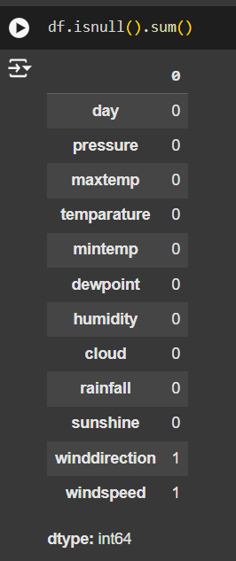
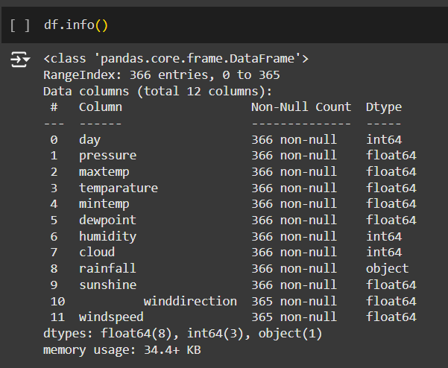
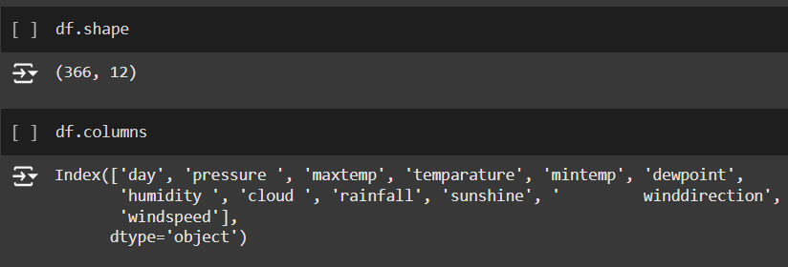
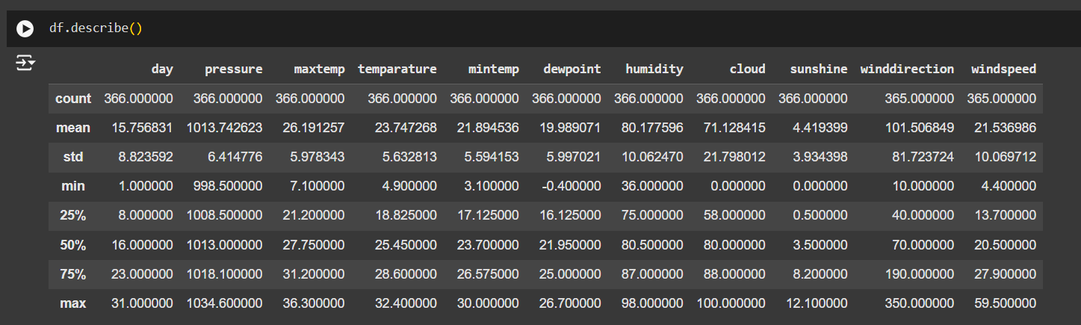
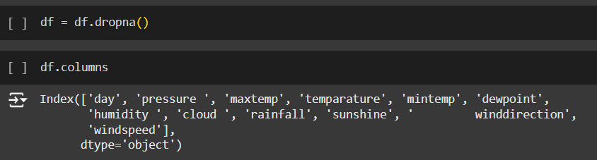
Data- Preprocessing

Slide 6
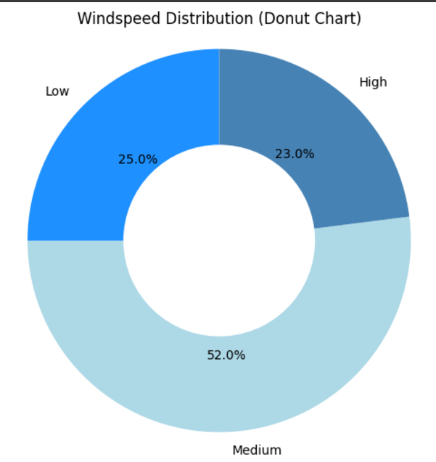
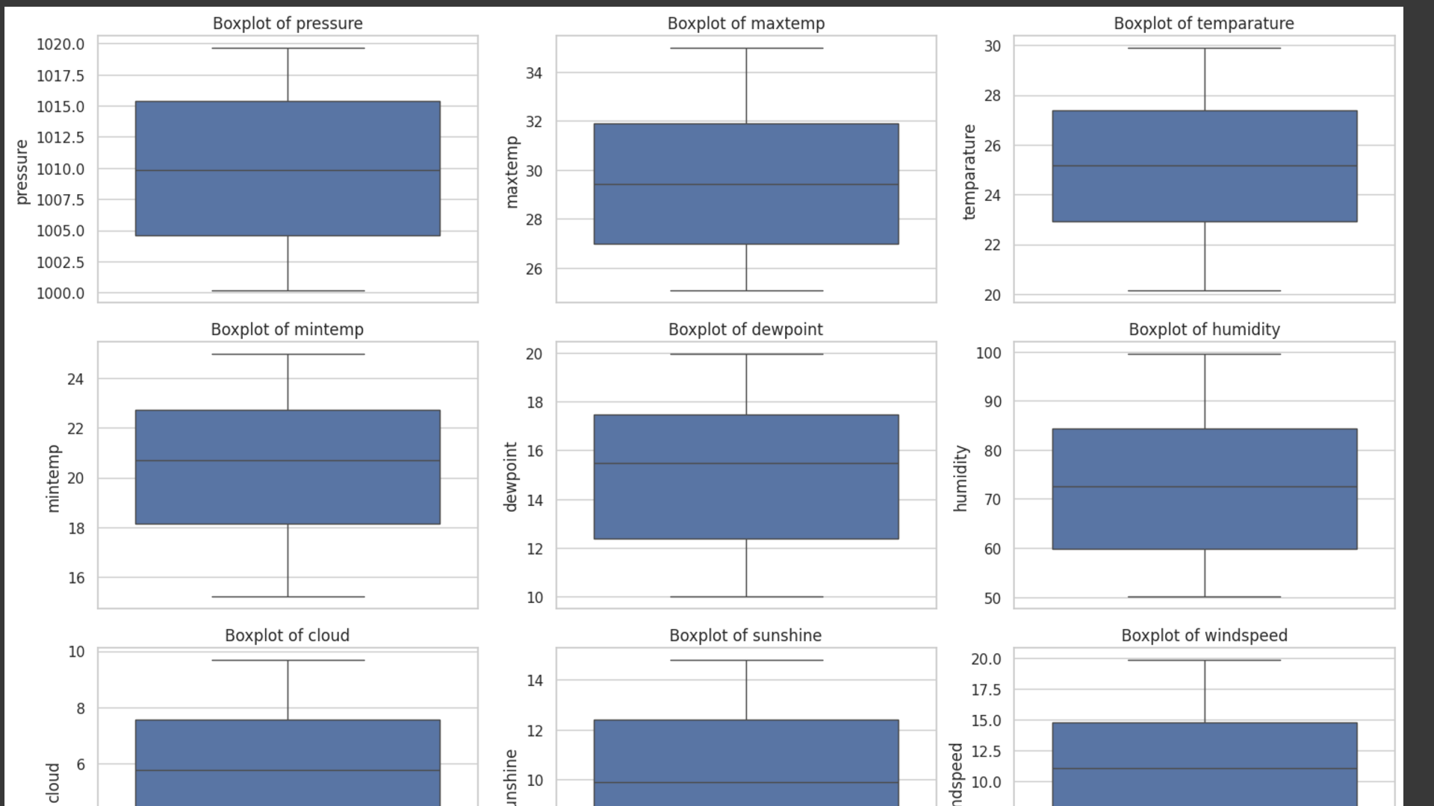
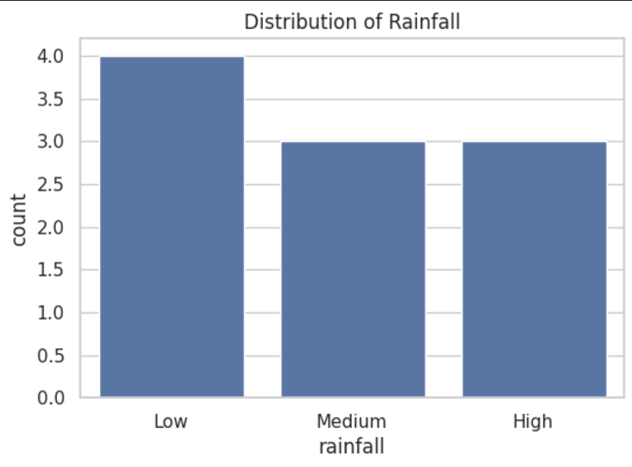
Data Visualization

Slide 7
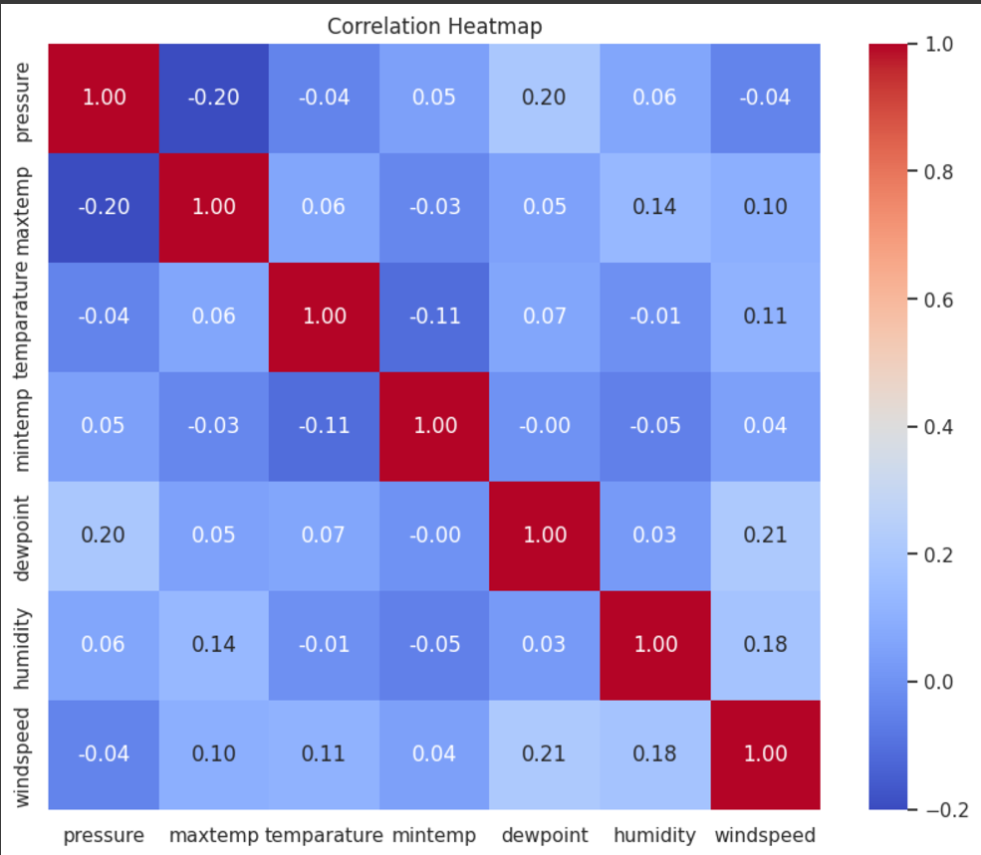
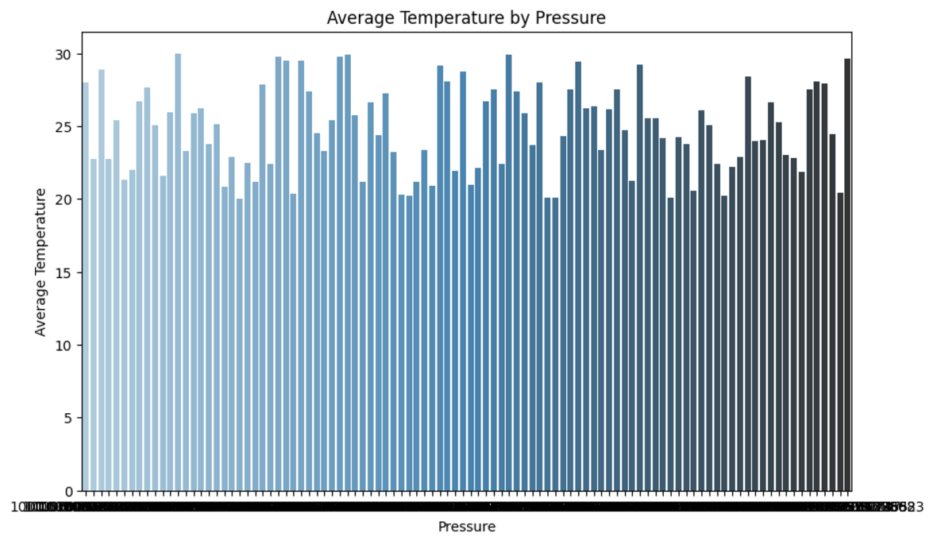
Data Visualization

Slide 8
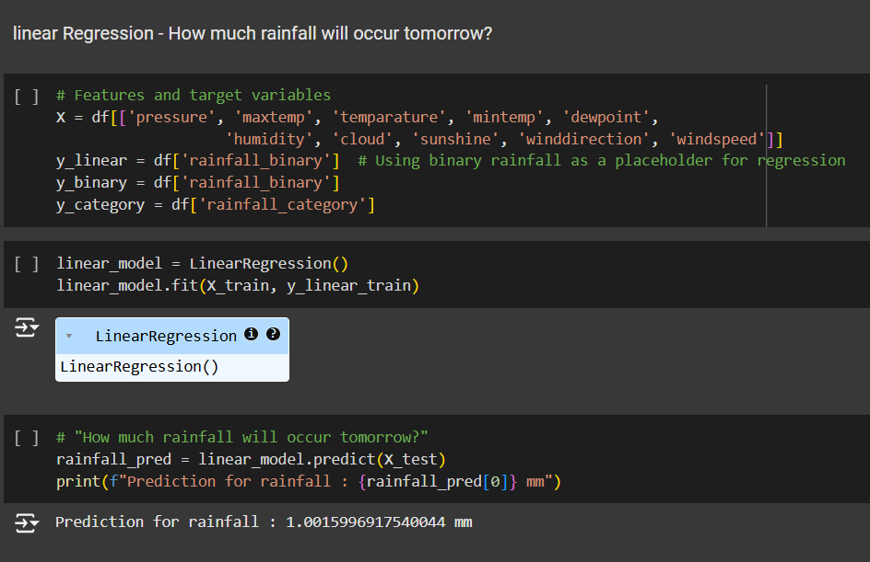
Machine Learning algorithms

Slide 9
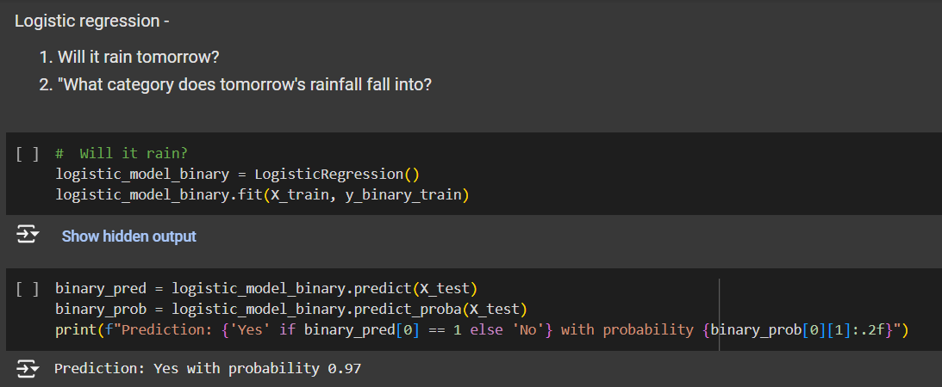
Machine Learning algorithms

Slide 10
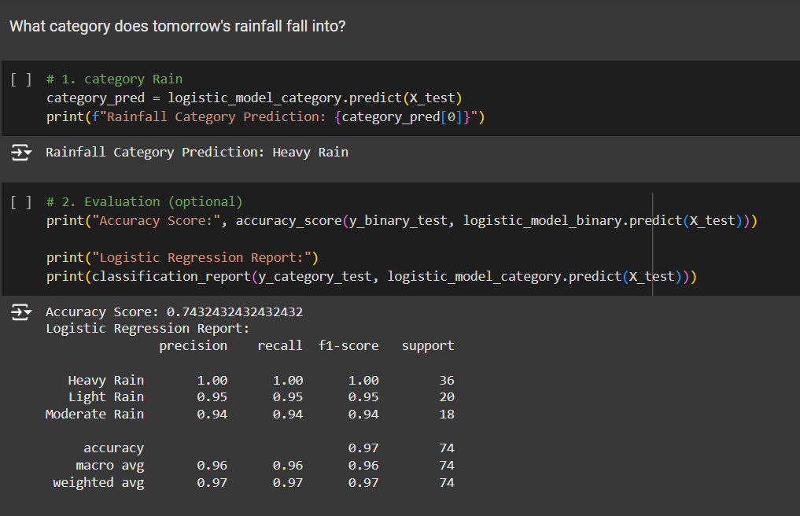
Machine Learning algorithms

Slide 11
Business Model Canvas
Problem
Crop yields are heavily influence by rainfall patterns.
Weather impacts shopping behavior.
Rain impacts delivery efficiency and road safety.
Key Activities
Data Collection and Preprocessing
AI Model Training and Optimization
Predictive Analytics Deployment
Visualization and Dashboard Development
Ongoing Model Refinement
Value Proposition-
Improved Crop Planning through Accurate Rainfall Predictions
Enhanced Logistics Safety and Efficiency
Data-Driven Retail Insights to Optimize Stock and Sales Strategies
Sustainable Water and Resource Management
Customer Segments
Farmers and Agri-Businesses
Retail Chains
Transportation and Logistics Providers
Municipal Water Resource Managers
Insurance Companies
Channels
Interactive Dashboards and Web Portals
Mobile Applications with Alerts and Insights
Partnerships with Government and NGOs
Integration with Supply Chain Management Systems
Key Resources
Historical Weather Data Sets
Skilled Data Scientists and Machine Learning Engineers
Kaggle
Cost Structure
Data Acquisition and Licensing Fees
Development and Maintenance of Prediction Models
Marketing and Partnership Development
Revenue Streams
Subscription-Based Prediction Services
Licensing of Predictive Models to Enterprises

Slide 12

Thank you
For watching
Scan me to check Project

Slide 13
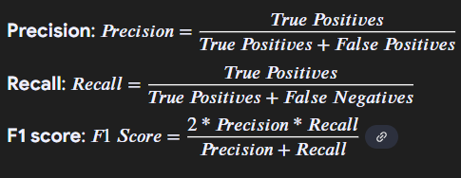
Accuracy:
Overall percentage of correct predictions.
Macro Avg:
Average of Precision, Recall, and F1 scores across all classes, giving equal weight to each class.
Weighted Avg:
Average of Precision, Recall, and F1 scores, weighted by the number of true instances for each class.

